Slide 1
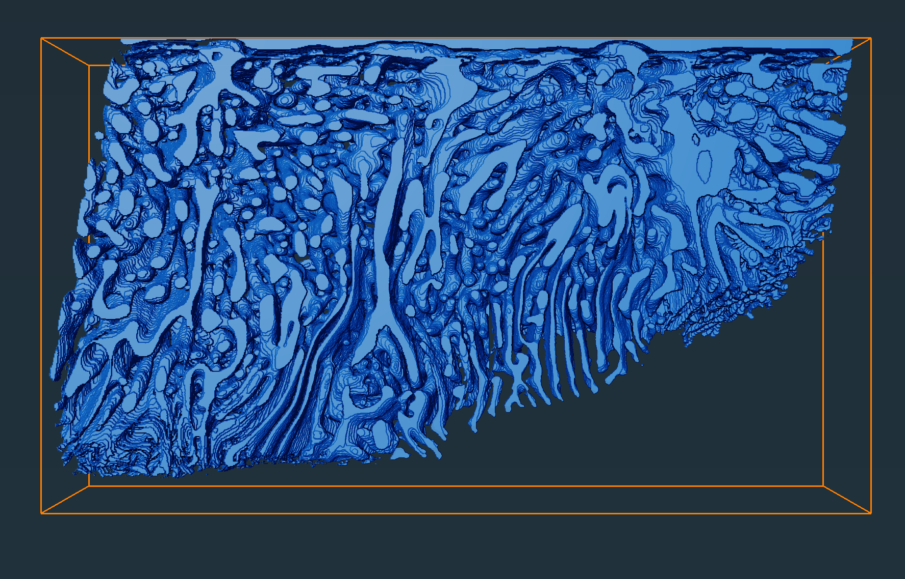
Volume fraction: 32.5%
Volume fraction: 29.5%
Volume fraction: 32.4%
8 µm x 8 µm x 6 µm
8 µm x 8 µm x 6 µm
8 µm x 8 µm x 6 µm
Volume fraction: 28.4%
8 µm x 8 µm x 6 µm
Average volume fraction: 31±2%
y
z
x

